Slide 1

Register transfer and micro operations: register transfer language; Arithmetic micro-operations
Computer Organization and Architecture | Register Organization
Course: Computer Organization and Architecture | Chapter: Register Organization | Program: Bachelor of Engineering
DISCOVER · LEARN · EMPOWER
Notes:
Welcome everyone to today's lecture on Register Organization. We will focus specifically on how we describe data movement and arithmetic operations using Register Transfer Language. This is the bridge between hardware design and software execution. Remember, every instruction you write eventually becomes a sequence of these micro-operations.

Slide 2
Course Outcomes
SLIDE 2 / 10
Course Outcome
CO | BT LEVEL | DESCRIPTION
CO1 | BT3 | Apply number systems and digital logic to design basic digital circuits
CO2 | BT4 | Analyze register organization and instruction set architecture
CO3 | BT3 | Implement computer arithmetic algorithms and floating-point operations
CO4 | BT5 | Analyze memory hierarchy and input-output organization
CO5 | BT6 | Evaluate control unit design and pipelining performance
Chandigarh University
2 / 10
Notes:
Today's session directly addresses Course Outcome 2, which requires you to analyze register organization. By understanding how registers interact and how arithmetic micro-operations are defined, you will be able to evaluate instruction set architectures effectively. This analysis is crucial for designing efficient processors.

Slide 3
Learning Objectives
SLIDE 3 / 10
Learning Outcomes
1
Define Register Transfer Language and its symbolic notation for data movement.
2
Analyze the syntax rules governing register transfer statements and control functions.
3
Classify arithmetic micro-operations including addition, subtraction, and incrementing.
4
Evaluate the hardware implementation requirements for basic arithmetic operations.
5
Apply RTL notation to describe specific data transfer and calculation sequences.
Chandigarh University
3 / 10
Notes:
By the end of this lecture, you will be able to define RTL and analyze its syntax rules. We will classify arithmetic micro-operations and evaluate their hardware needs. Finally, you will apply this notation to describe data sequences. For example, you will learn to write 'R1 ← R2 + R3' to represent an addition.

Slide 4
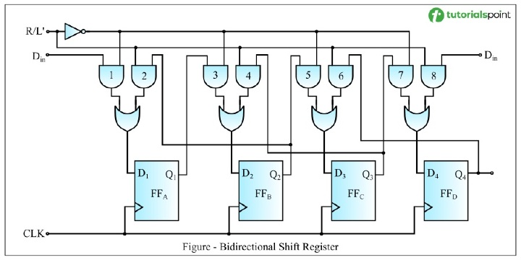
Lecture
SLIDE 4 / 10
Register Transfer Language Definition
1
RTL is a symbolic notation used to describe micro-operations in digital systems.
2
The arrow symbol (←) denotes the transfer of data from source to destination.
3
Registers are represented by uppercase letters followed by numbers like R1 or MAR.
4
Data movement occurs only during a specific clock pulse triggered by control signals.
5
RTL abstracts hardware details to focus on the logical flow of information.
Bidirectional Shift Register in Digital Electronics
Chandigarh University
4 / 10
Notes:
Register Transfer Language is our shorthand for describing how data moves inside the CPU. The arrow symbol means data moves from the right side to the left side. For instance, 'R1 ← R2' means the content of R2 is copied into R1. This happens only when a specific control signal is active during a clock cycle.

Slide 5
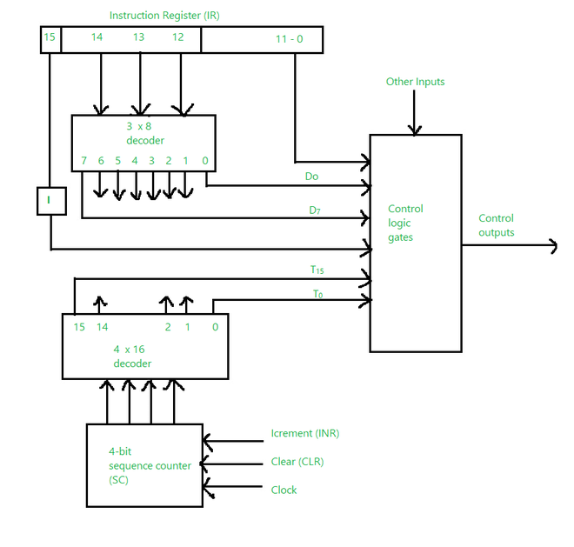
Lecture
SLIDE 5 / 10
Control Functions in RTL
1
Control functions act as conditional switches that enable or disable data transfer.
2
A control function is written in parentheses, such as (P), before the arrow.
3
The transfer occurs if and only if the control variable P equals logic 1.
4
Multiple control functions can be combined using logical AND operations.
5
This mechanism ensures data moves only when specific conditions are met.
Source: media.geeksforgeeks.org
Chandigarh University
5 / 10
Notes:
Control functions act like conditional switches for our data transfers. If we write 'P: R1 ← R2', the transfer happens only if P is 1. If P is 0, the register R1 remains unchanged. This allows us to implement complex decision logic directly in the hardware description.

Slide 6
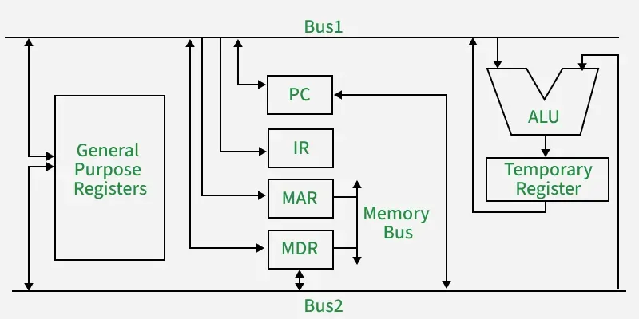
Lecture
SLIDE 6 / 10
Arithmetic Micro-operations
1
Arithmetic micro-operations perform basic mathematical calculations on binary data.
2
Common operations include addition, subtraction, increment, and decrement of values.
3
These operations are performed by the Arithmetic Logic Unit (ALU).
4
The result of an arithmetic operation is typically stored in a destination register.
5
Carry bits are often generated and stored in a separate flip-flop.
Source: media.geeksforgeeks.org
Chandigarh University
6 / 10
Notes:
Arithmetic micro-operations are the mathematical heart of the processor. They include addition, subtraction, and incrementing. The ALU performs these calculations on the binary data held in registers. For example, adding two 8-bit numbers might produce a 9-bit result where the 9th bit is the carry.

Slide 7
Lecture
SLIDE 7 / 10
RTL for Arithmetic Operations
1
Addition is denoted as R3 ← R1 + R2, summing contents of R1 and R2.
2
Subtraction is denoted as R1 ← R1 - R2, subtracting R2 from R1.
3
Increment operation is written as R1 ← R1 + 1, adding one to the value.
4
Decrement operation is written as R1 ← R1 - 1, subtracting one from the value.
5
These notations clearly specify the source operands and the destination for the result.
Chandigarh University
7 / 10
Notes:
Let's look at the specific syntax for these operations. Addition is written as R3 ← R1 + R2. Subtraction is R1 ← R1 - R2. Incrementing is simply R1 ← R1 + 1. These notations make it easy to read and design the control logic for the ALU.

Slide 8
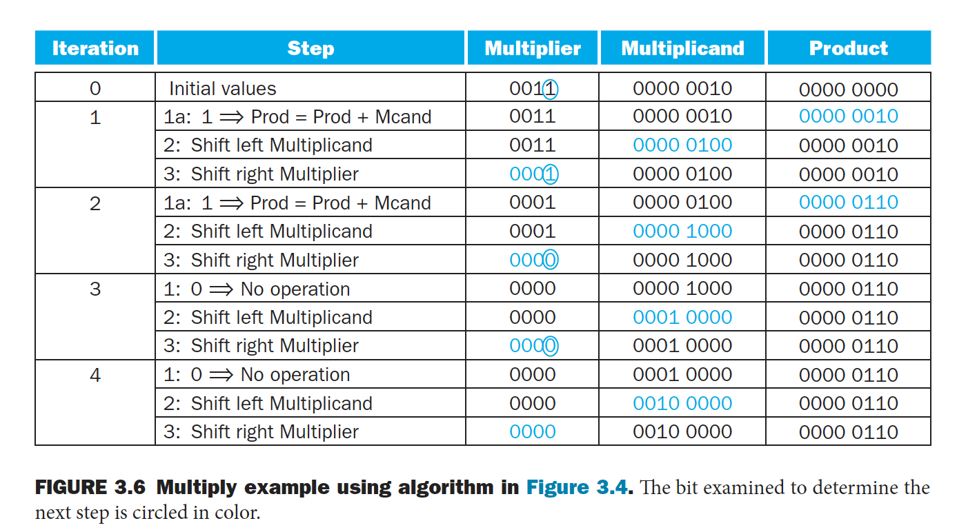
Lecture
SLIDE 8 / 10
Worked Numerical Example
1
Assume R1 contains binary 0101 (decimal 5) and R2 contains 0011 (decimal 3).
2
Executing R3 ← R1 + R2 results in R3 containing 1000 (decimal 8).
3
Executing R1 ← R1 - R2 results in R1 containing 0010 (decimal 2).
4
Executing R1 ← R1 + 1 results in R1 containing 0011 (decimal 3).
5
The carry flip-flop C is set to 0 for these specific 4-bit additions.
Source: media.cheggcdn.com
Chandigarh University
8 / 10
Notes:
Let's work through a concrete example. If R1 is 5 and R2 is 3, adding them gives 8 in R3. If we subtract R2 from R1, we get 2. If we increment R1, it becomes 3. This demonstrates how the ALU processes binary data based on the micro-operations defined in RTL.

Slide 9
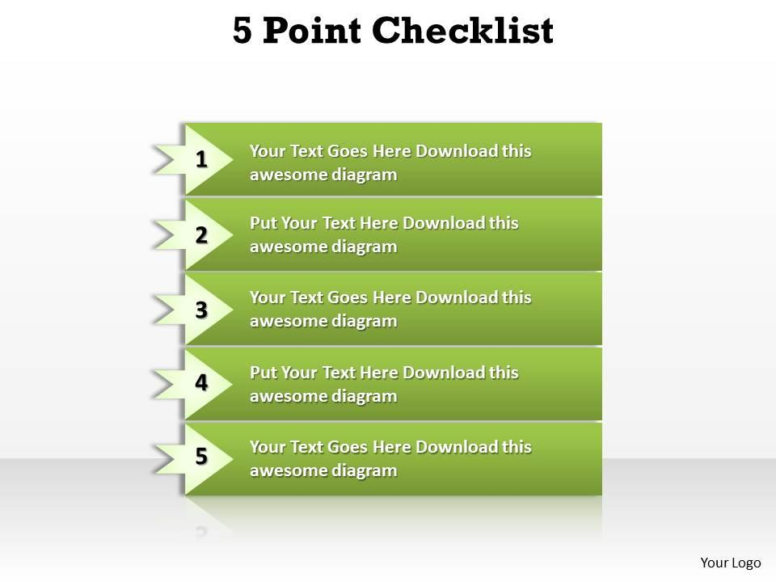
Lecture
SLIDE 9 / 10
Key Takeaways
1
RTL provides a concise symbolic notation for describing data transfer and processing.
2
The arrow (←) indicates data movement from source to destination register.
3
Control functions in parentheses determine the conditional execution of transfers.
4
Arithmetic micro-operations include addition, subtraction, increment, and decrement.
5
These operations are executed by the ALU and stored in destination registers.
Source: www.slideteam.net
Chandigarh University
9 / 10
Notes:
To summarize, RTL is our symbolic language for data movement. The arrow shows where data goes, and control functions decide when it moves. We covered arithmetic operations like addition and subtraction, which are handled by the ALU. Mastering this notation is essential for understanding how instructions are executed.

Slide 10
Lecture
SLIDE 10 / 10
References
COMPUTER ORGANIZATION AND DESIGN
The Hardware/Software Interface — David A. Patterson, John L. Hennessy
COMPUTER ARCHITECTURE
A Quantitative Approach — John L. Hennessy, David A. Patterson
• Computer Organization and Architecture — William Stallings
• Computer System Architecture — M. Morris Mano & Rajib Mall
• Computer Organization — Carl Hamacher, Zvonko Vranesic, Safwat Zaky
Chandigarh University
10 / 10
Notes:
For further reading, please refer to the standard textbooks listed here. Stallings and Mano provide excellent foundational coverage of register organization. Patterson and Hennessy offer deep insights into the hardware-software interface. These resources will support your understanding of the concepts discussed today.

